Slide 1
Math 210 – Communicating in Math

Slide 2
Events!
Auto-Owners job interview prep session (Tuesday, Feb 12, 12-2 pm, MAK B-1-110 (Career Fair on Feb 21!)
Research showcase (Wednesday, Feb 13, 5 pm, PCS -MAK A-2-610)
Graduate school panel (Friday, Feb 15, 1 pm, MAK B-1-110)
Improv Games, Whose Math is it Anyways? (Wed, Feb 18, MAK B-1-110

Slide 7
Group Norms
We will…
Validate each others efforts and contributions
Be patient and listen (really listen) to everyone’s ideas
Say your ideas even if you’re not sure it’s right. Participate!
Be open minded to other people’s ideas.
Not be bossy.
Dr. Keough will…
Be open to suggestions
Not move on too quickly if people don’t understand
Offer guidance but not give things away

Slide 8
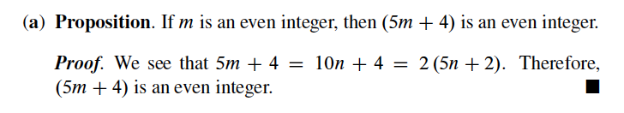
19a

Slide 9
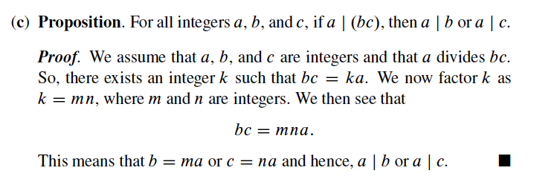
19c

